Slide 1
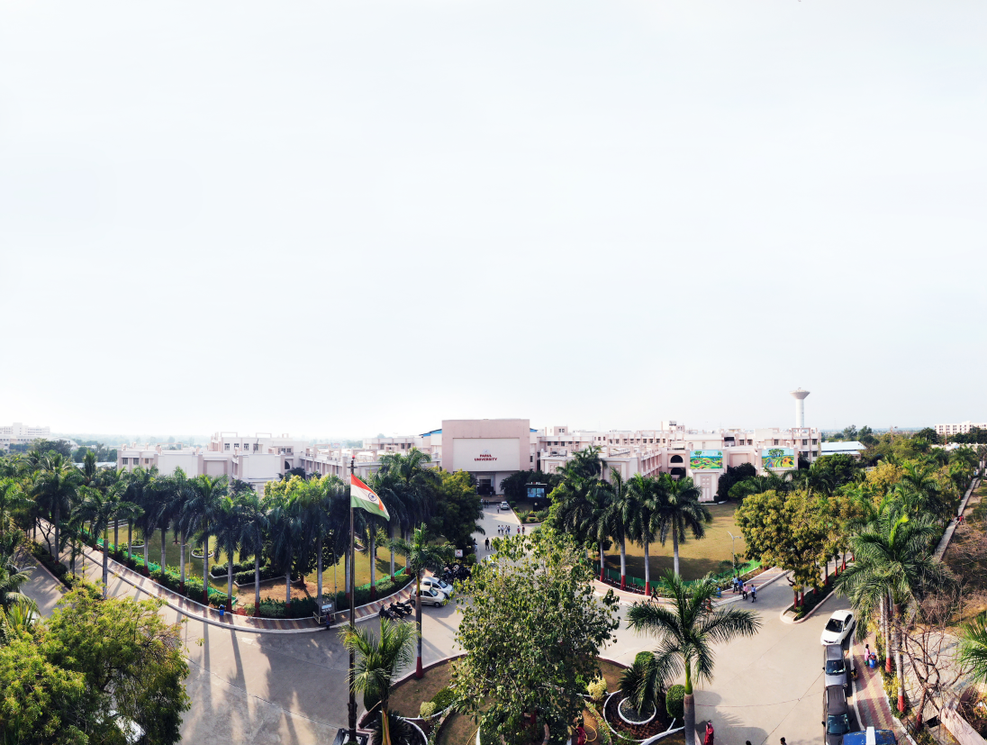


Object Oriented Concepts with UML 203105207
Prof. Shaleen Shukla, Assistant Professor
Information Technology

Slide 2
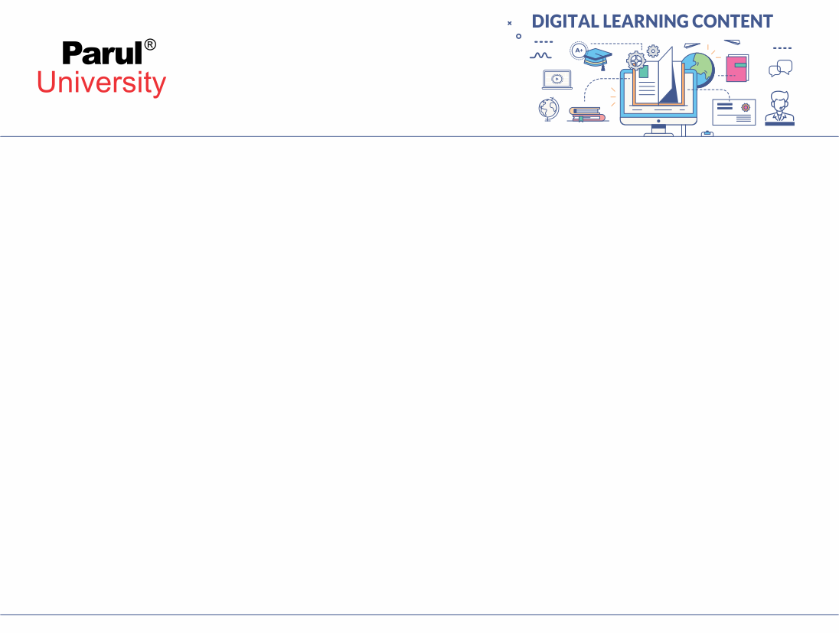

CHAPTER-5
System Design

Slide 3
What is System Design?
System design is the high-level strategy for solving the problem and building a solution.
It includes decisions about the organization of the system into subsystems, the allocation of subsystems to hardware and software components and major conceptual and policy decisions that form the framework for detailed design.
During analysis, the focus is on what needs to be done, independent of how it is done. During design, decisions are made about how the problem will be solved, first at high level, then at increasingly detailed levels.
Image source : Google

Slide 4
What is System Design?
It is the first design stage in which the basic approach to solving the problem is selected.
During system design, the overall structure and style are decided
The architecture provides the context in which more detailed decisions are made in later design stages.
The architecture provides the context in which more detailed decisions are made in later design stages.

Slide 5
What is System Design?
The system designer must make the following decisions:
Organize the system into subsystems.
Identify concurrency inherent to the problem.
Allocate subsystems to processors and tasks.
Choose an approach for management of data.
Handle access to global resources.
Choose the implementation of control in s/w
Handle boundary conditions.
Set trade-off priorities.
Image source : Google

Slide 6
Breaking a System Into Subsystems
First step in system design is to divide the system into a small number of components.
Each subsystem encompasses aspects of the system that share some common property: similar functionality, the same physical location or execution on the same kind of hardware

Slide 7
Breaking a System Into Subsystems
A subsystem is not an object nor a function but a package of classes, associations, operations, events and constraints that are interrelated and that have a reasonably well-defined and small interface with other subsystems.
A subsystem is usually identified by the service it provides.
A service is a group of related functions that share some common purpose, such as I/O processing, drawing pictures.

Slide 8
Breaking a System Into Subsystems
Each subsystem has a well defined interface to the rest of the system. The interface specifies the form of all interactions and the information flow across subsystem boundaries but does not specify how the subsystem is implemented internally.
Subsystems should be defined in such a manner that it has more cohesion and less coupling.
The relationship between two subsystems can be client-supplier or peer-to-peer.

Slide 9
Breaking a System Into Subsystems
The decomposition of systems into subsystems may be organised as a sequence of horizontal layers or vertical partitions.

Slide 10
Layers
A layered system is an ordered set of virtual worlds, each built in terms of the ones below it and providing the basis of implementation for the ones above it.
The objects in each layer can be independent, having some interaction with other layers.
A subsystem knows about the layers below it, but has no knowledge of the layers above it.
Layered architecture come in two forms: closed and open.

Slide 11
Layers
In closed architecture, each layer is built only in terms of the immediate lower layer. This reduces the dependencies between layers and allows changes to be made most easily because a layer’s interface only affect the next layer.
In an open architecture, a layer can use features of any lower layer to any depth. This reduces the need to redefine operations at each level, which can result in a more efficient and compact code.
Open architecture does not observe the principle of information hiding. Changes to a subsystem can affect any higher subsystem, so an open architecture is less robust than a closed architecture.

Slide 12
Partition
Partitions vertically divide a system into several independent or weakly-coupled subsystems, each providing one kind of service.
The subsystems may have some knowledge of each other, but this knowledge is not deep, so major design dependencies are not created.

Slide 13
Identifying Concurrency
In the analysis model, as in the real world and in hardware, all objects are concurrent.
An important goal of system design is to identify which objects must be active concurrently and which objects have activity that is mutually exclusive.
The dynamic model is the guide to identifying concurrency.
Two objects are inherently concurrent if they can receive events at the same time without interacting.

Slide 14
Identifying Concurrency
If the events are unsynchronized, the objects cannot be folded onto a single thread of control.
Two subsystems that are inherently concurrent need not necessarily be implemented as separate hardware units.

Slide 15
Defining Concurrent Tasks
Although all objects are conceptually concurrent, in practice many objects in a system are interdependent.
By examining the state diagrams of individual objects and the exchange of events among them, many objects can often be folded together onto a single thread of control.
A thread of control is a path through a set of state diagrams on which only a single object at a time is active.

Slide 16
Defining Concurrent Tasks
A thread of control is a path through a set of state diagrams on which only a single object at a time is active.
A thread remains within a state diagram until an object sends an event to another object and waits for another event.
The thread passes to the receiver of the event until it eventually returns to the original object.
The thread split if the objects sends an event and continues executing.

Slide 17
Allocating Subsystems to Processors and Tasks
A thread of control is a path through a set of state diagrams on which only a single object at a time is active.
A thread remains within a state diagram until an object sends an event to another object and waits for another event.
The thread passes to the receiver of the event until it eventually returns to the original object.
The thread split if the objects sends an event and continues executing.

Slide 18
Allocating Subsystems to Processors and Tasks
Determine the connectivity of the physical units that implement the subsystem.
The decision to use multiple processors or hardware functional units is based on a need for higher performance than a single CPU can provide.
The system designer must estimate the required CPU processing power by computing the steady state load as the product of the number of transactions per second and the time required to process a transaction.

Slide 19
Management of Data Stores
The following guidelines characterize the kind of data that belongs in a file and not in a relational database:
Data that is voluminous in quantity but difficult to structure within the confines of DBMS.
Data that is voluminous in quantity and of low information density.
“Raw” data that is summarized in the database.
Volatile data that is kept a short time and then discarded.

Slide 20
Handling Global Resources
The system designer must identify global resources and determine mechanisms for controlling access to them. Global resources include: physical units, such as processors, communication satellites; Disk space and databases.
If a resource is a physical object, then it can control itself by establishing a protocol for obtaining access within a concurrent system.
If a resource is a logical entity, such as database, then there is danger of conflicting access in a shared environment.

Slide 21
Handling Global Resources
The system designer must identify global resources and determine mechanisms for controlling access to them. Global resources include: physical units, such as processors, communication satellites; Disk space and databases.
If a resource is a physical object, then it can control itself by establishing a protocol for obtaining access within a concurrent system.
If a resource is a logical entity, such as database, then there is danger of conflicting access in a shared environment.

Slide 22
External Control: Concurrent Systems
In a concurrent system, control resides concurrent in several independent objects, each a separate task. Events are implemented directly as one way message between objects.
One task can wait for input, but other tasks continue execution.
The OS usually supplies a queuing mechanism for events so that events are not lost if a task is executing when they arrive.

Slide 23
Batch Transformation
A batch transformation is a sequential input-to-output transformation, in which inputs are supplied at the start and the goal is to compute an answer.
The steps in designing a batch processing transformation are:
Break the overall transformation into stages, each stage performing one part of the transformation.
Define intermediate object classes for the data flows between each pair of successive stages.
Expand each stage in turn until the operations are straightforward to implement.
Restructure the final pipeline for optimization.

Slide 24
Continuous Transformation
A continuous transformation is a system in which the outputs actively depend on changing inputs and must be periodically updated.
since a complete re-computation is impossible for every input value change, an architecture for a continuous transformation must facilitate incremental computation. The transformation can be implemented as a pipeline of functions.
The effect of each incremental change in an input value must be propagated through pipeline.

Slide 25
Continuous Transformation
Synchronization of values within the pipeline may be important for high-performance systems.
In such cases, operations are performed at well-defined times and the flow path of operations must be carefully balanced so that values arrive at the right place at the right time.

Slide 26
Continuous Transformation
The steps in designing a pipeline for a continuous transformation are:
Draw a data flow diagram for the system
Define intermediate objects between each pair of successive stages, as in the batch transformation.
Differentiate each operation to obtain incremental changes to each stage.
Add additional intermediate objects for optimization.

Slide 27
Interactive Interface
An interactive interface is a system that is dominated by interactions between the system and external agents, such as humans, devices or other programs.
It usually includes part of an entire application which can often be handled independently from the computational part of the application.
The major concerns of an interactive interface are the communications protocol between the system and the external agents, the syntax of possible interactions, the presentation of output.

Slide 28
Interactive Interface
Interactive interfaces are dominated by the dynamic model. The steps in designing an interactive interface are:
Isolate the objects that form the interface from the objects that define the semantics of the application.
Use predefined objects to interact with external agents.
Use the dynamic model as the structure of the program. Interactive interfaces are best implemented using concurrent control or event-driven control.
Isolate physical events from logical events.
Fully specify the application functions that are invoked by the interface. Make sure that the information to implement them is present.

Slide 29
Dynamic Simulation
A dynamic simulation models or tracks objects in the real world.
Traditional methodologies built on data flow diagrams are poor at representing these problems because simulations involve many distinct objects that constantly update themselves, rather than a single large transformation.

Slide 30
Dynamic Simulation
The steps in designing a dynamic simulation are:
Identify actors, active real-world objects, from the object model
Identify discrete events.
Identify continuous dependencies.
Generally a simulation is driven by a timing loop at a fine time scale.
The hardest problem with simulation is usually providing adequate performance.

Slide 31
Real time System
A real time system is an interactive system for which time constraints on actions are particularly tight or in which the slightest timing failure cannot be tolerated.
For critical actions, the system must be guaranteed to respond within an absolute interval of time.
Typical application include process control, data acquisition, communication devices etc.

Slide 32
Transaction Manager
A transaction manager is a database system whose main function is to store and access information. The information comes from the application domain.
The steps in designing a transaction manager are:
Map the object model directly into a database.
Determine the units of concurrency.
Determine the unit of transaction.
Design concurrency control for transactions.

Slide 33


www.paruluniversity.ac.in

